Slide 2
Dazzling Dashboards: Finesse Your Formatting
#data17
Richard Durval
Stephen Price

Slide 3


Stephen Price Product Consultant. I come from Quito, Ecuador. Primary region is LAC. Language fan. Nowadays my hair is tidier.

Slide 4


Richard Durval Team Lead LAC Product Consulting. Primary region is Brazil. Hometown: Austin, TX. Harley enthusiast (love my Sporty). Also had messy hair.

Slide 5

I formatted my hair.

Slide 6
Resources
Starting Workbook:
Contains all data sets used in the session, IMDB data about movies!
Located in the Session folder.
Guided Website:
Step-by-step walkthrough of exercises.
Contains exercises and extra challenges.
Hands-On Training Assistants:
Will be walking around the room for your questions throughout the session.
Raise your hand for help – don’t be shy!

Slide 7
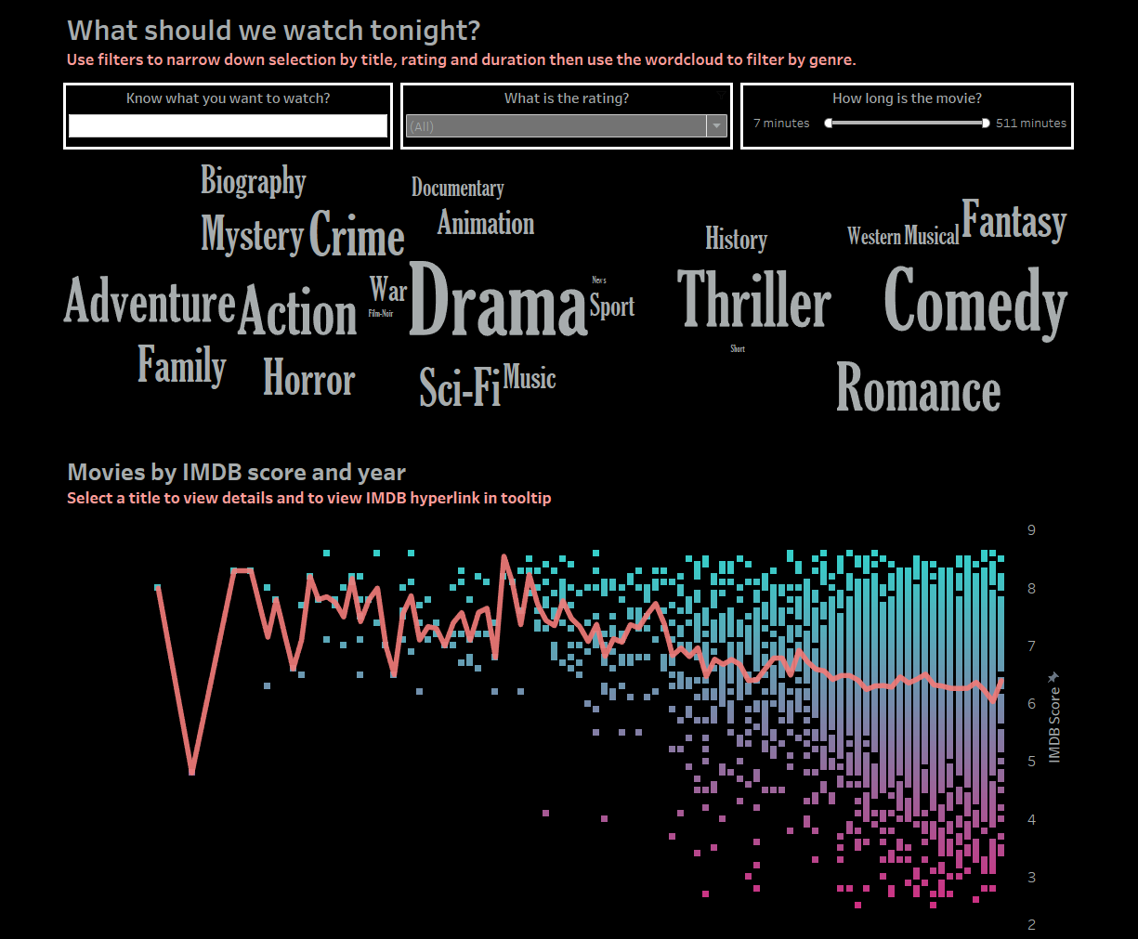
Why Format?
Create Expressive Visual Content:
Dazzle audiences with well designed dashboards.
Make your content stand out from the crowd.
Create an enjoyable experience for the end user.
Complement your Story:
Align your dashboards with corporate color palettes.
Use images relevant to your message.
Enhance your Analysis:
Highlight areas of interest using colors.
Use fonts to write clear labels and tooltips.
Scale your formatting across an entire workbook and datasource.
(There will also be a break half way through!)

Slide 8
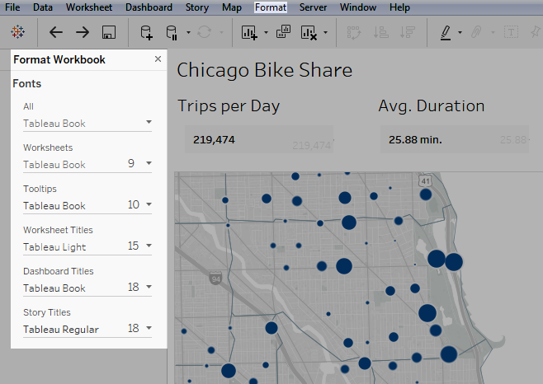
Formatting Best Practices
Format from largest to smallest.
Focus the narrative.
Change and limit color with purpose.
Use fonts that optimize online readability.
Remove clutter.
Reinforce your story with tooltips.
Improve context.

Slide 9
Formatting Basics

Slide 10
Format Largest to Smallest
Workbook
Dashboard
Worksheet

Slide 11
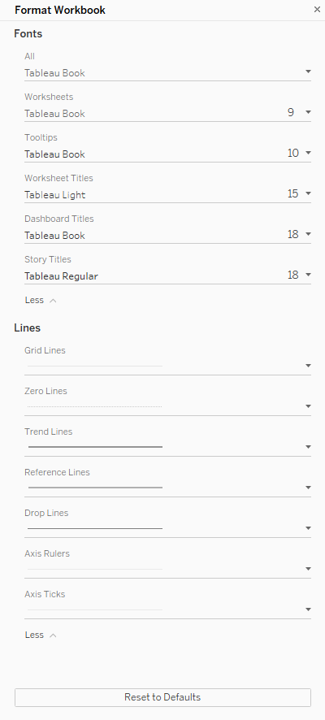
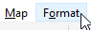
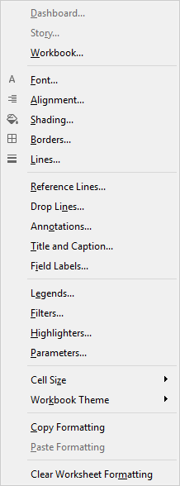
Workbook Formatting
Workbook Level
Font styling.
Titles.
Lines.
Reset defaults.

Slide 12
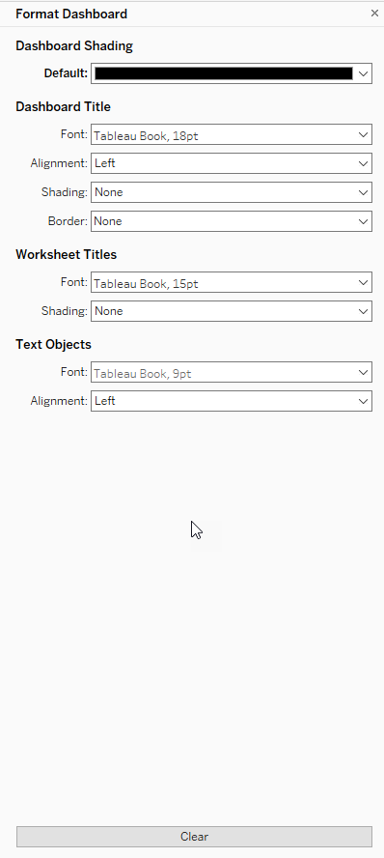
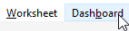
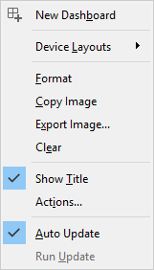
Dashboard Formatting
Dashboard Level
Shading
Titles
Borders
Text Objects
Clear.

Slide 13

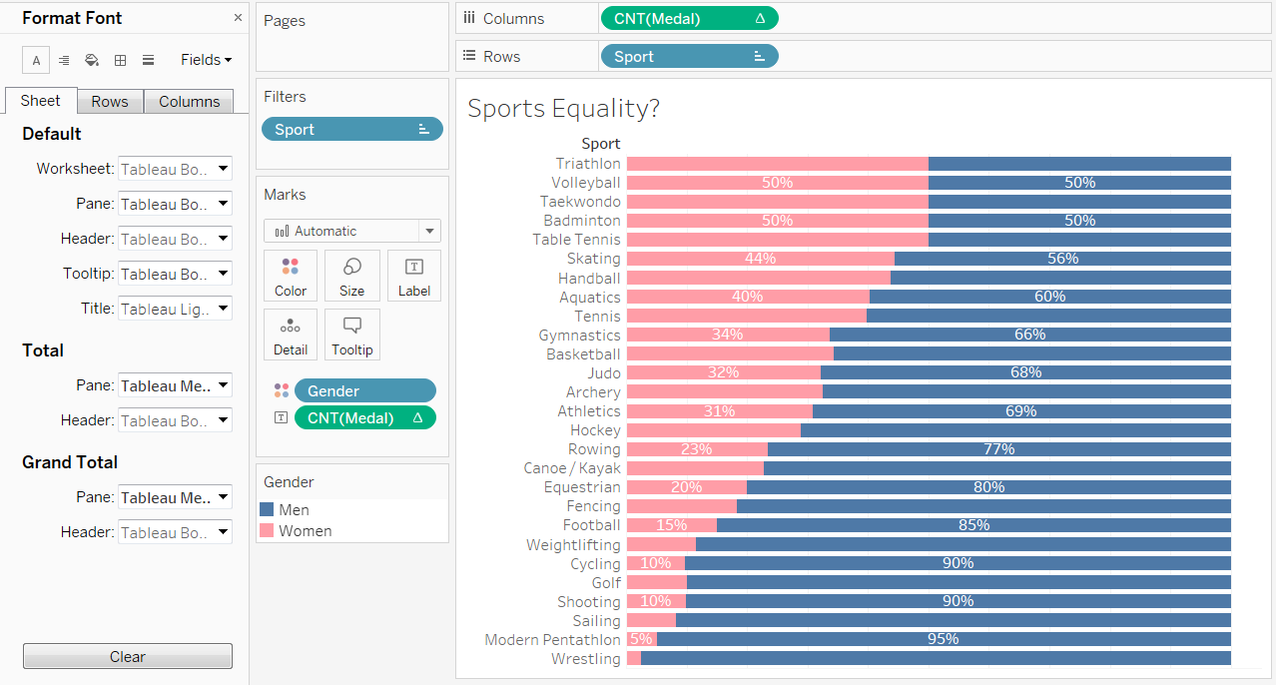
Format Pane
Worksheet Level
Fonts.
Alignment.
Shading.
Borders.
Lines.

Slide 14
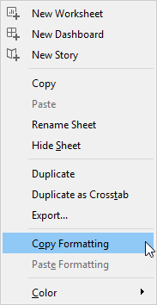
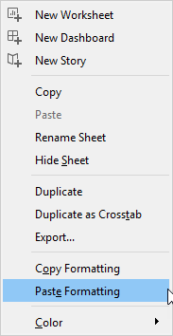
Replicate Formatting with Copy and Paste
Anything you set in the Format pane.
Except reference lines and annotations.
Manual sizing and level of zoom is not copied.

Slide 15
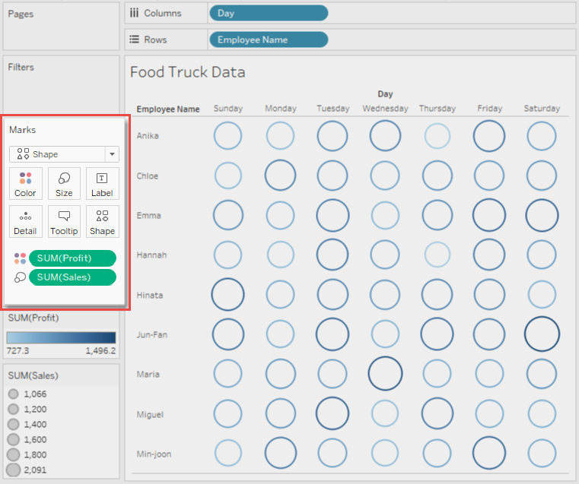
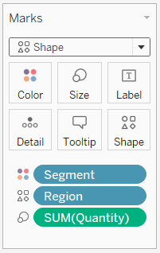
The Marks Card

Slide 16
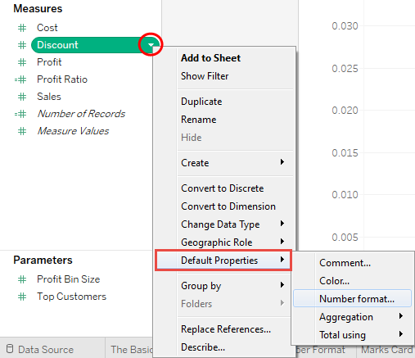
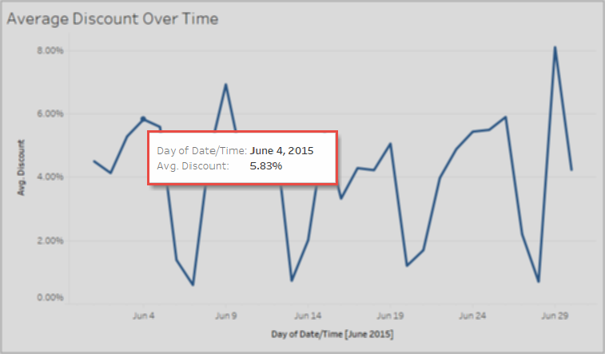
Default Properties

Slide 17
DEMO

Slide 18
Exercise: Basic + Workbook and Dashboard Level Formatting.

Slide 19

Formatting for Style

Slide 20
Formatting Colors

Slide 21
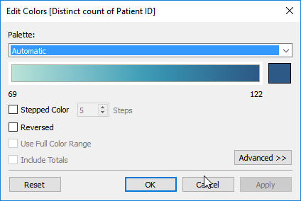
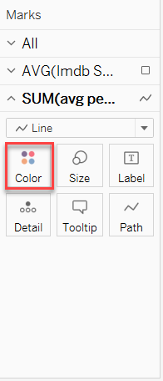
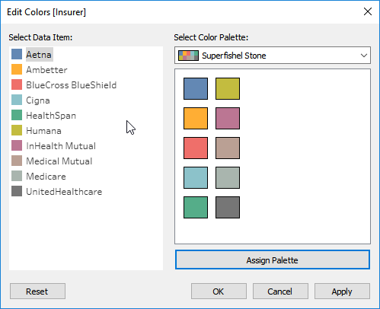
Colors: The Basics

Slide 22
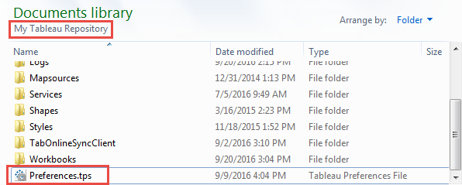
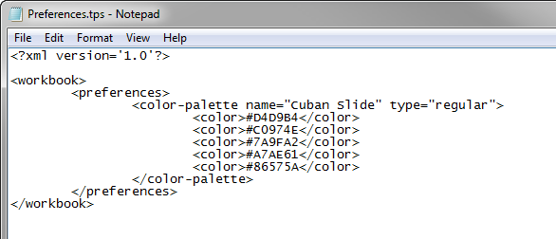
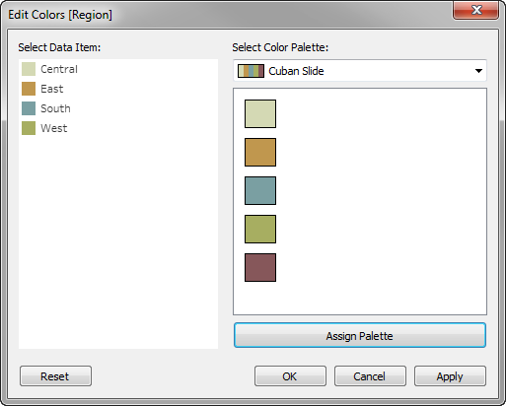
Categorical. Sequential. Diverging.
Colors: Custom Palettes
1
2
3

Slide 23
Preferences.tps
<workbook>
</workbook>

Slide 24
Preferences.tps
<workbook>
<preferences>
</preferences>
</workbook>

Slide 25
Preferences.tps
<workbook>
<preferences>
<color-palette name=“My Custom Palette" type="regular">
<color>#D4D9B4</color>
<color>#C0974E</color>
<color>#7A9FA2</color>
<color>#A7AE61</color>
</color-palette>
</preferences>
</workbook>

Slide 26
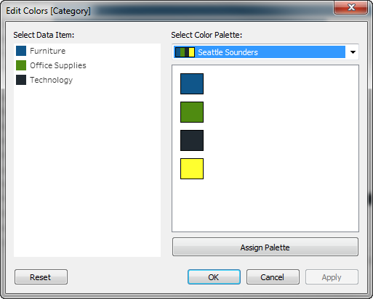
Categorical
Preferences.tps
Color Palette
<color-palette name="Seattle Sounders" type="regular”
<color>#10568a</color>
<color>#4f8b11</color>
<color>#202930</color>
<color>#ffff2f</color>
</color-palette>

Slide 27
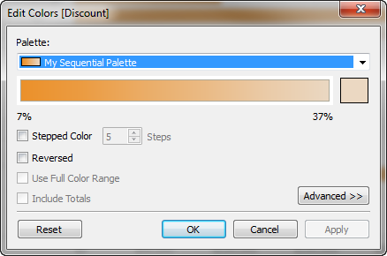
Sequential
Preferences.tps
Color Palette
<color-palette name="My Sequential Palette" type="ordered-sequential" > <color>#eb912b</color> <color>#eb9c42</color> <color>#ebad67</color> <color>#eabb86</color> <color>#eacba8</color> <color>#ebd8c2</color> </color-palette>

Slide 28
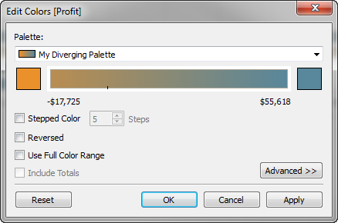
Diverging
Preferences.tps
Color Palette
<color-palette name="My Diverging Palette" type="ordered-diverging"> <color>#eb912b</color> <color>#59879b</color> </color-palette>
Tap icon to add content

Slide 29
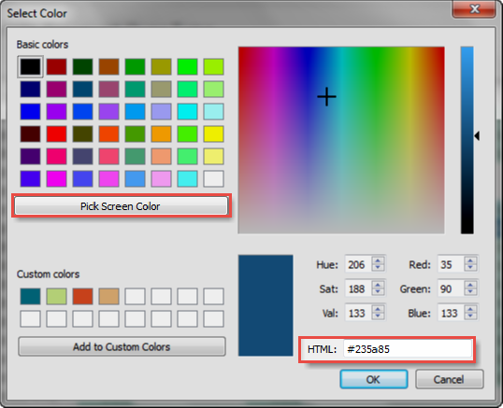
Finding HEX Codes Using Tableau!

Slide 30
Exercise: Custom Colors

Slide 31
Custom Shapes

Slide 32
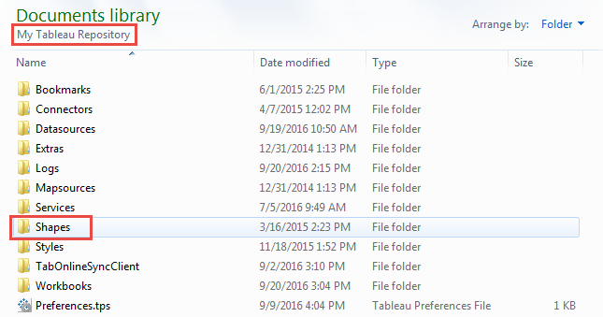
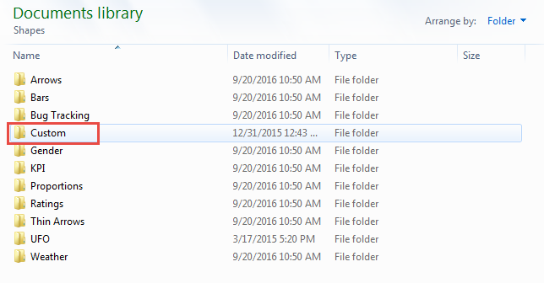
Adding Custom Shapes

Slide 33

Custom Shapes
Best Practices
Suggested size: 32 x 32 pixels.
Use a transparent background (.gif and .png).
Supported file formats: .gif, .png, .jpg, .bmp, .tiff.
Don’t forget to reload shapes!

Slide 34
DEMO

Slide 35
Exercise: Custom Shapes

Slide 36
Formatting your Axes

Slide 37
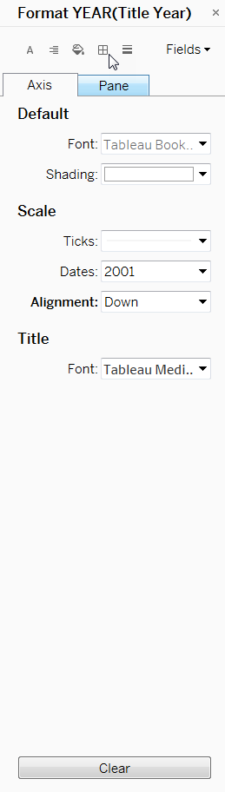
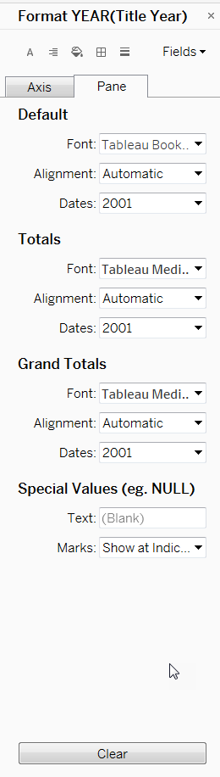
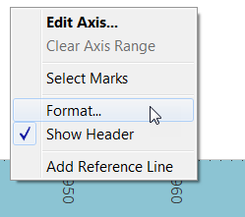
Formatting Axis
Aesthetic Changes
Fonts
Shading
Number/ date format
Alignment
Special Values

Slide 38
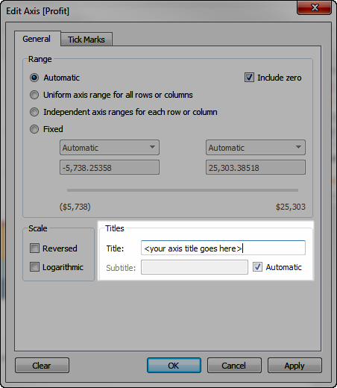
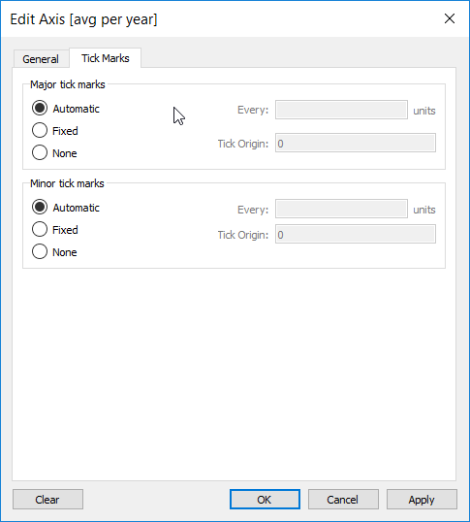
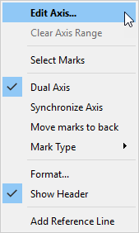
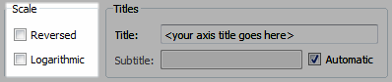
Edit Axis

Slide 39
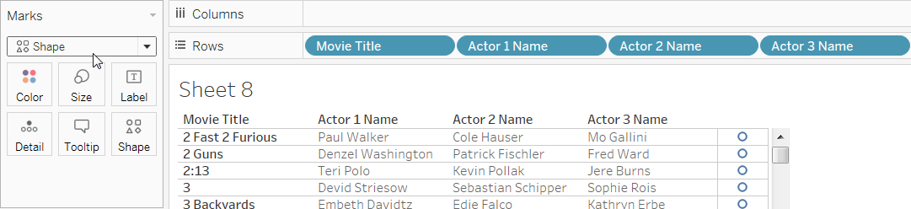
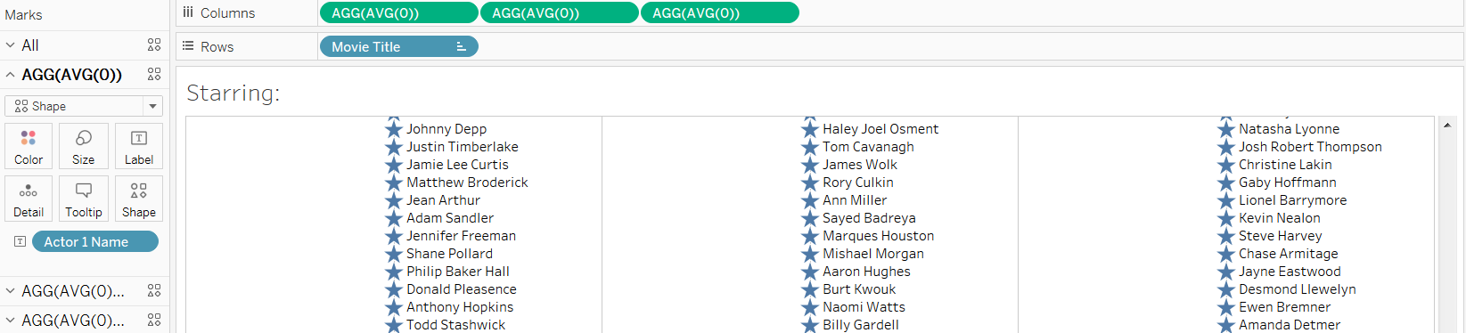
Using Axis to Tweak Visualizations

Slide 40
DEMO

Slide 41
Exercise: Axis

Slide 42

Clear Communication

Slide 43
Tooltips, Titles, Filters and Highlighters.

Slide 44
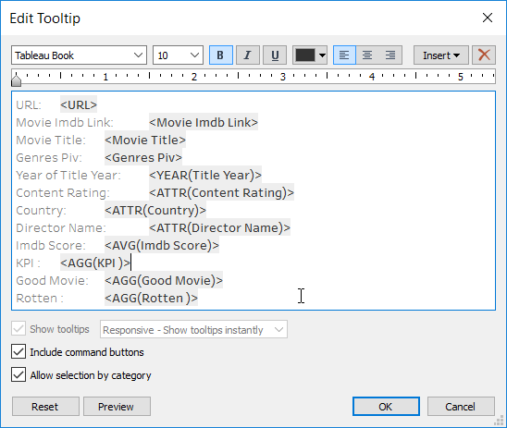
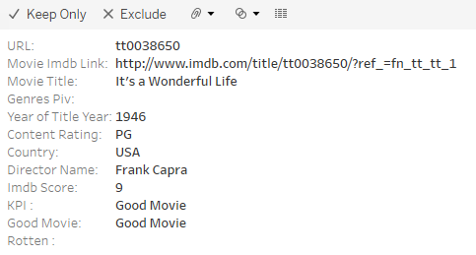
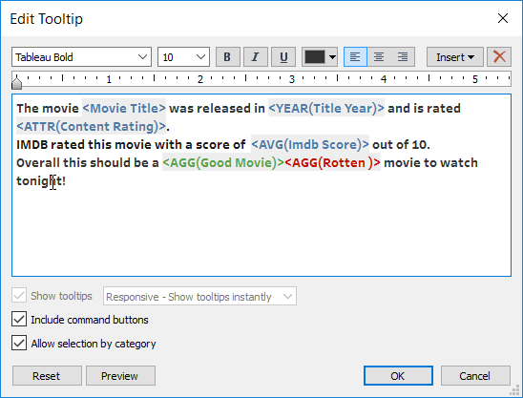
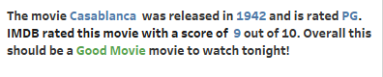
Tooltips Need to Make Sense
Insert only relevant data.
Use colors and fonts wisely.
Design for user interactivity.
Use tooltips only when needed.
Include command buttons wisely.
Default
Formatted

Slide 45
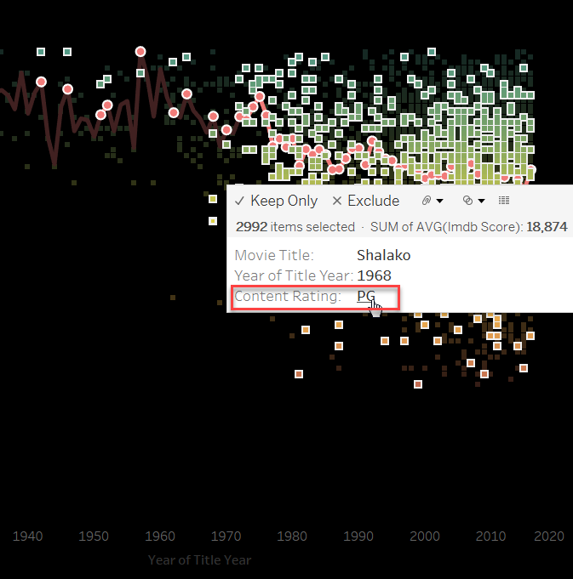
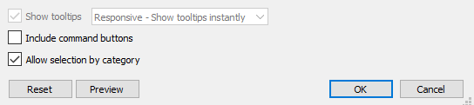
Allow Selection by Category
New in 10.3.
Interactive.
Highlights similar marks.
Great for Ad Hoc exploration.
Turn on or off.

Slide 46
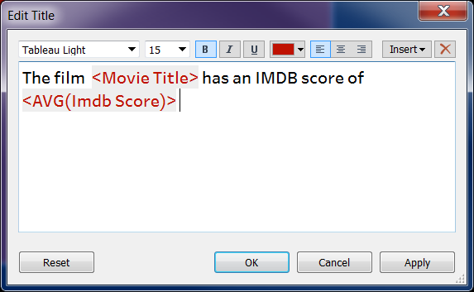
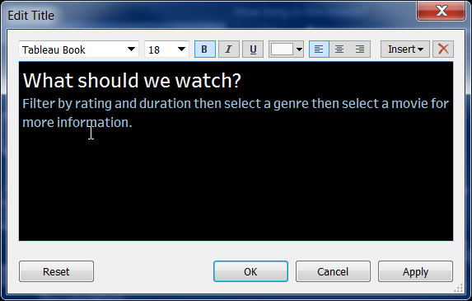
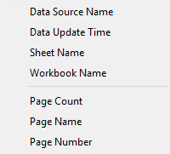
Dynamic and Informative Titles
Interactive and Dynamic
Guides the User
Data Driven

Slide 47
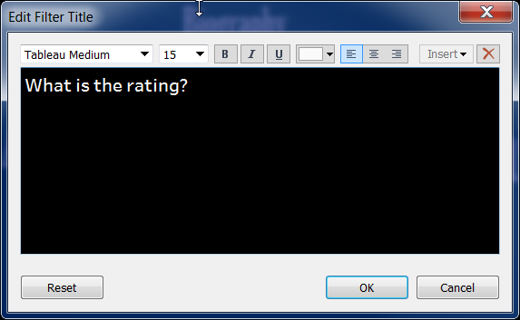
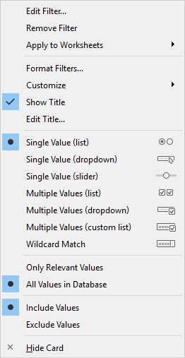
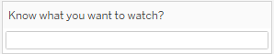
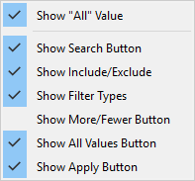
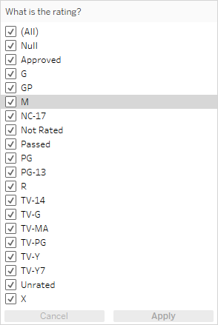
Making Filters Functional
Make titles relevant.
Be user focused.
Customize usability.
Apply button.
Show only relevant values.

Slide 48
DEMO

Slide 49
Exercise: Tooltips, Titles and Filters

Slide 50
Putting It All Together In A Dashboard

Slide 51




Images for Interactivity

Slide 52

Images for Infographic Styling
Fix axis.
Hide header.
Size correctly.
Add image to dashboard (.png).
Use Dashboard Actions.

Slide 53



New Formatting in 10.4
Precise dashboard spacing.
Set an item's size and position.
Reorder floating objects.
Add padding.
Border and background controls.
High DPI support for Windows.
Notes:
SIZE AND POSITION: If you want a high degree of control over the size and position of every item in a dashboard, and if you're also using Fixed size or Rangefor overall dashboard sizing, use the settings on the Layout pane. This is where you can control an object or view's exact position, size, and other characteristics.
The Item hierarchy area on the Layout tab shows the relationships between objects on your dashboard. Drag floating items in the hierarchy to change how they layer over each other. Items at the top of the list appear in the front, while items at the bottom appear in back.
Padding lets you precisely space items on dashboard, while borders and background colors let you visually highlight them. Inner padding sets the spacing between item contents and the perimeter of the border and background color; outer padding provides additional spacing beyond the border and background color.
If DPI scaling is enabled on your Windows machines, you can now author your views with confidence, knowing that that they will look as beautiful at 100% scaling as they do at 200% scaling.

Slide 54





Dashboard Building Toolkit
Tiled vs Floating
Positioning
Padding
Sizing
Distribute Evenly
Objects and Containers

Slide 55
DEMO

Slide 56
Exercise: Putting it all Together!

Slide 57
Are you ready to format your world?
Best practices
Consistency
Marks
Defaults
Custom colors
Custom palettes
Custom shapes
New in 10.4
Labels
Tooltips
Axes
Dashboards
Actions
Interactivity
Titles
Designing with a purpose

Slide 58
Tuesday, October 10
2:00 PM - 4:30 PM
Dazzling Dashboards: Finesse Your Formatting
Wednesday, October 11
10:15 AM - 12:45 PM
Dazzling Dashboards: Finesse Your Formatting
Thursday, October 12
10:30 AM - 1:00 PM
Dazzling Dashboards: Finesse Your Formatting

Slide 59
Wednesday, October 11
Stylish, seamless formatting
Wednesday, October 11
Don't gamble on your dashboard: Effective Visual Design
Thursday, October 12
Gettin' Vizzy With It: Advanced Visualization Types

Slide 60

Please complete the session survey from the Session Details screen in your TC17 app

Slide 61
BONUS SECTION!!!

Slide 62
“Formatting” Data
My data isn’t cooperating with me!
- I want to build a word cloud but…
Issues with data format
Reshaping might be tough
Tableau can help!

Slide 63
Data formatting toolkit
What we can accomplish in Tableau
- Changing data types
Pivots
Editing aliases
Splits and custom splits
Groups
Calculated fields
Lets get creative with our toolkit!

Slide 64

Not a good format for in Excel

Slide 65

Still not looking good in Tableau

Slide 66


Tableau Toolkit

Slide 67

Why can’t I pivot?
Now what do I do!?

Slide 68


What tools do we have available?

Slide 69

Tableau to the rescue

Slide 70

Pivot!
Success!

Slide 71

Now you can make a word cloud!

